Slide 1
MalDash: A Network Traffic Dashboard for Malware Analysis
Josh Messitte, Eli Burstiner
CSCI 8240: Software Security & Cyber Forensics

Slide 2

Imagine…
You are browsing the web…
cs.uga.edu

Slide 3

Then
You get hit with ransomware…
cs.uga.edu

Slide 4
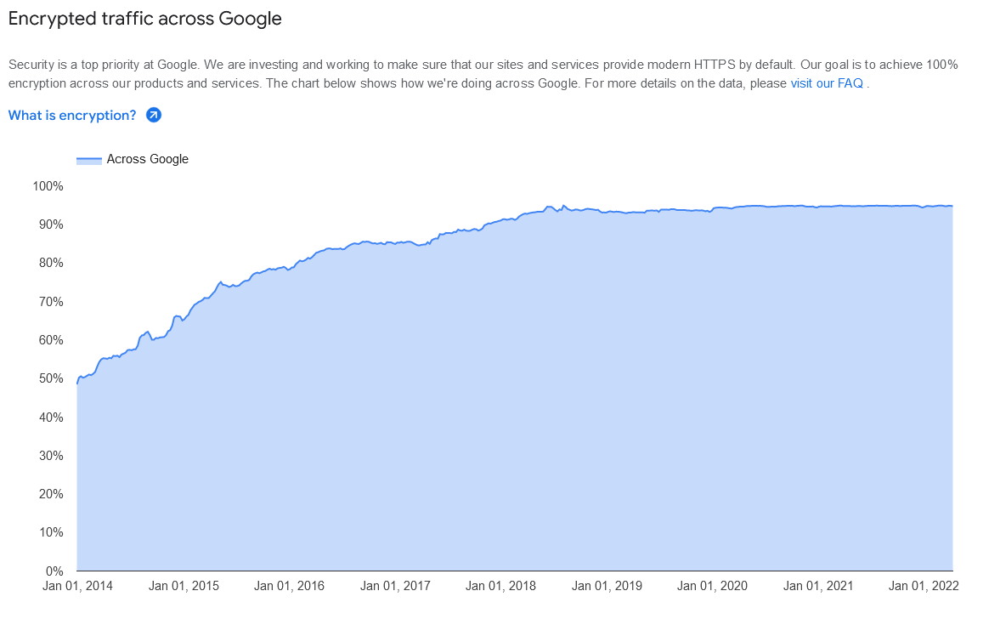
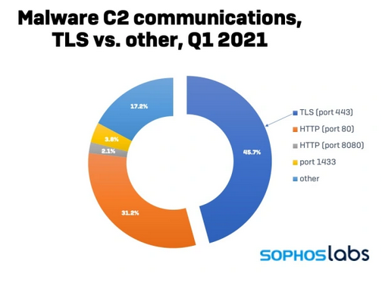
The Problem
Attackers are hiding malware communications in encrypted network traffic.
cs.uga.edu

Slide 5
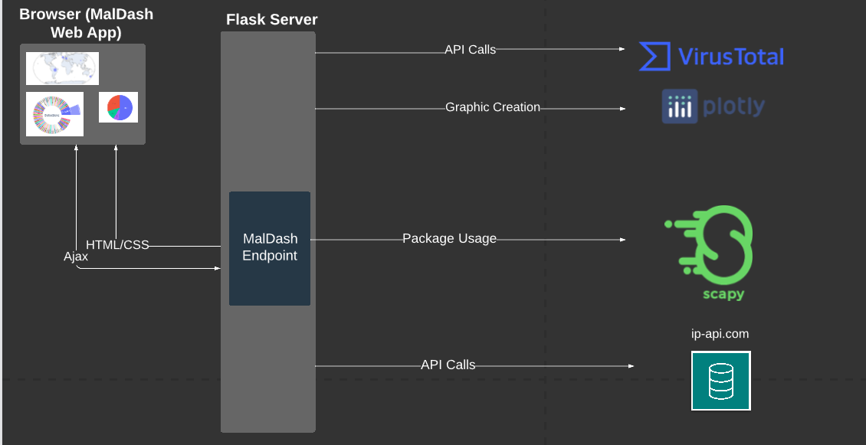
The Solution
cs.uga.edu

Slide 6

Scapy
* Powerful Python program for packet manipulation.
* Breaks capture into individual packets.
* Track capture statistics with ease.
* View packets in a human-readable fashion.
cs.uga.edu

Slide 7

VirusTotal
* Online tool for malware detection.
* Retrieve file properties (file type, hashes, etc.).
* Detect any malware from their known vendor database.
cs.uga.edu

Slide 8
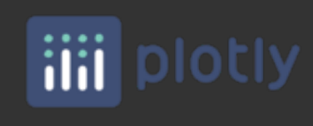
Plotly
* Online graphics, analytics and statistics tools.
* Create meaningful graphics to display on front-end.
cs.uga.edu

Slide 9
Live Demo
Server running locally:
http://localhost:5000/
cs.uga.edu

Slide 10
Advantages
* Reduces barrier of entry for malware analysts.
* Collects info from various places and displays it in one place.
cs.uga.edu

Slide 11
Future Directions
* Implement Random Forest ML model that will extract features from a set of captures and be able to classify new samples.
* Improve UX/UI
cs.uga.edu

Slide 12
Thank You! Questions?
https://github.com/joshmess/MalDash
Josh Messitte
https://joshmessitte.dev
Joshua.Messitte@uga.edu
Eli Burstiner
Eli.Burstiner@uga.edu
cs.uga.edu

